Slide 1
the master’s infrastructure
will never dismantle
the master’s platforms

Slide 2

Niels ten Oever, PhD
Postdoctoral Researcher
University of Amsterdam
IN-SIGHT.it
mail@nielstenoever.net
https://nielstenoever.net
@nielstenoever
Notes:
Hi, am Niels
Uni of AMS
Previously IETF, ICANN, RIPE, IEEE
Now more 3GPP
Wired Norms diss
Interested in power and global communications networks

Slide 3
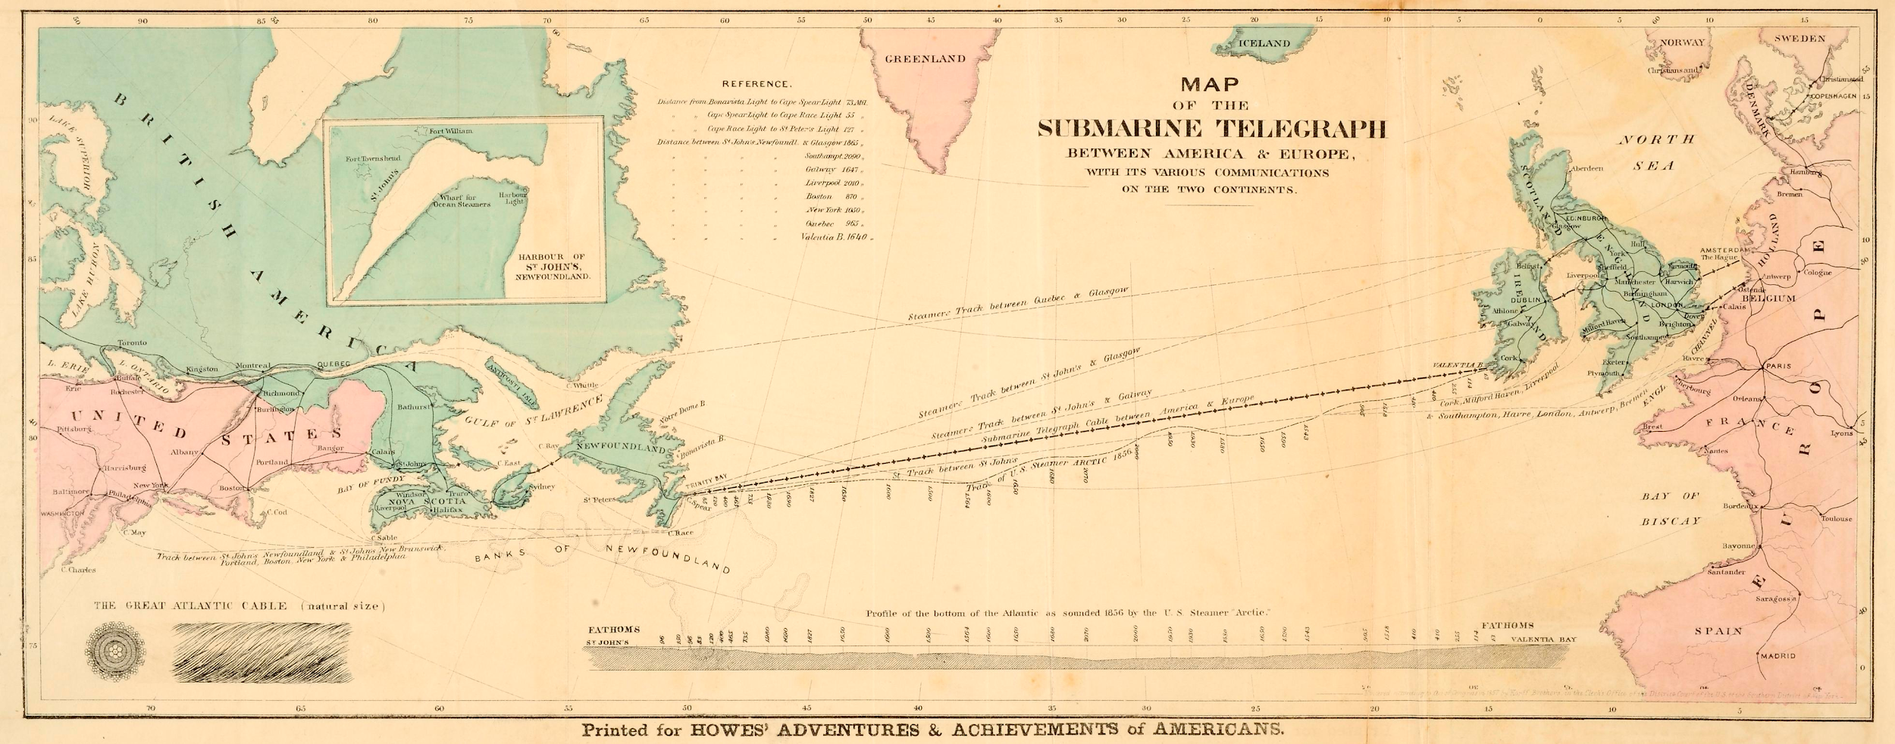
Notes:
First intercontinental comms network in 1865. Worked on for three years, worked for three weeks.
History of communications and standardization is a history of failure and much as it is of success
German Bundeskanzler wanted to communicate with US President from his boat, but could not due to diff int standards

Slide 4
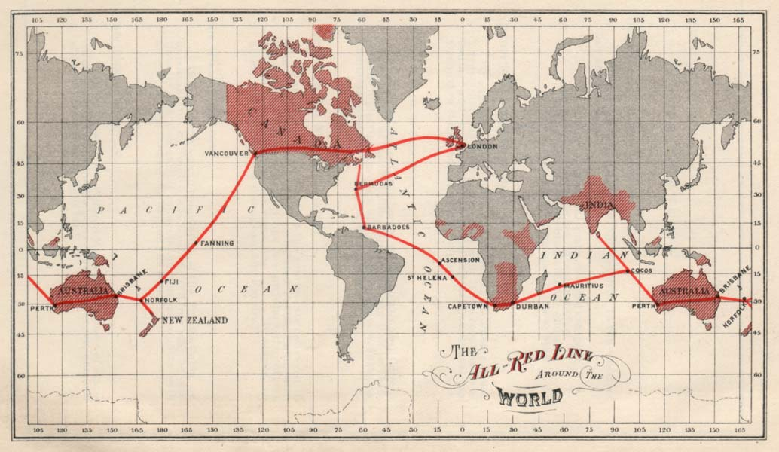
Notes:
Communications networks are always are proxy for power and intrinsically linked with militarism and colonialism
Telegraph changed colonialism to imperialism by establishing centers of power
The location of the center and locus of power and the removal of friction is a returning concept in communication networks
It determines the ability of decisionmakers to exert power of a topological empire, that topographically might be hard to even imagine

Slide 5
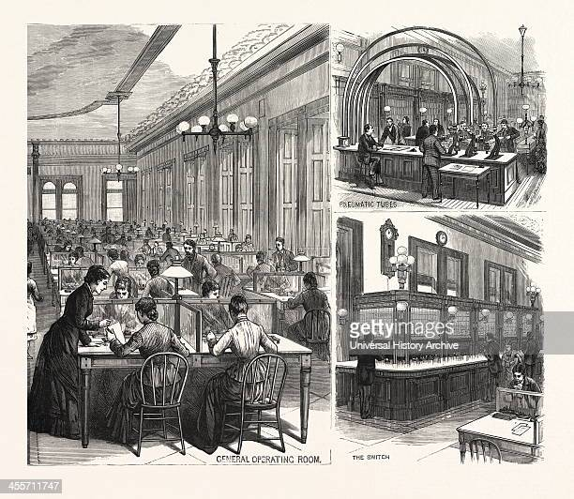
Notes:
History of global communication networks is also a forgotten history
Of women operators, female programmers, and maintainers and institutions that make infrastructure work
Infrastructure is inherently relational: standards and people are as much part of it as the fysical infrastructure

Slide 6





Notes:
The story of telecommunications is also bound in institutions. To ensure that the debacle of 1865 was not to be repeated, the International Telegraph Union was established.
Oldest still functioning global governance body
Since 1947 part of the United Nations - governened all comms networks: telegraph, telegram, telephone, radio, TV, spectrum
until…….

Slide 7

Notes:
October 1957
Societ Union launched artificial satellite
TIME magazine: those chilling beeps
Americans were terrified
Established Advanced Research Projects Agency

Slide 8
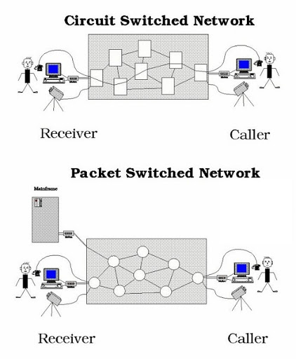
Notes:
Previous networks were circuit switched - needing continuous connection. Imagine a continuous flow. Very stable, but deal badly with interruptions
ARPAnet, as design criterium, needed to be able to withstand nuclear strike. Therefore distributed and decentralized. Made use of packet switching.
Packets, little trucks, etc.

Slide 9
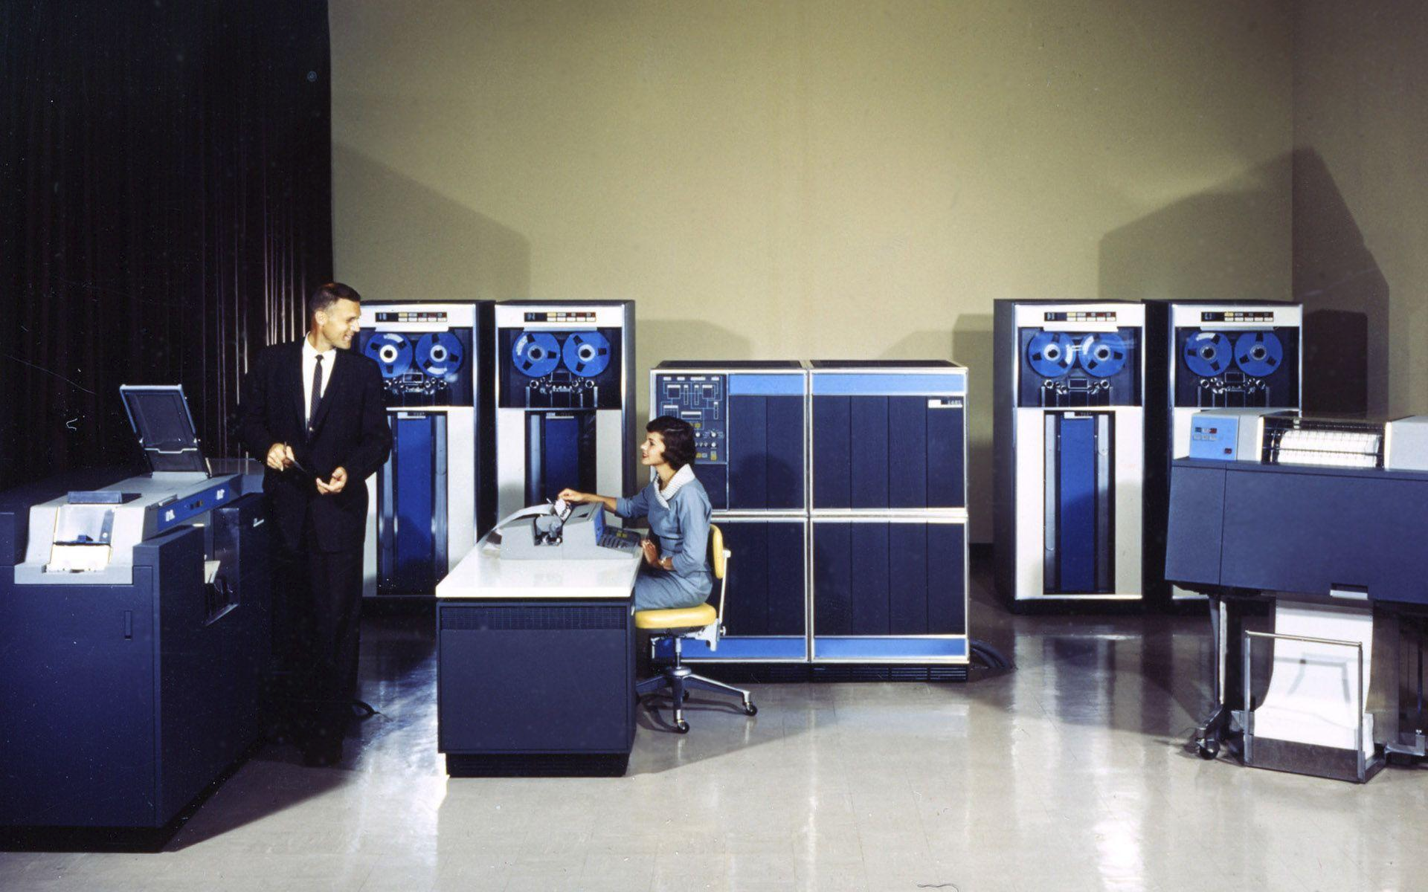
Notes:
In circuit switching: the network is SMART
In packet swithcing: the end-poiints are SMART and the network is DUMB.
Network only exists to transport packets, not to translate, hand over, or control.
In telco networks, the networks were the locus of power. Owned by and standardized by states (Europe and colonial powers) or monopolies (US: Western Union)
In packet switched networks, the end-points were the locus of power.

Slide 10
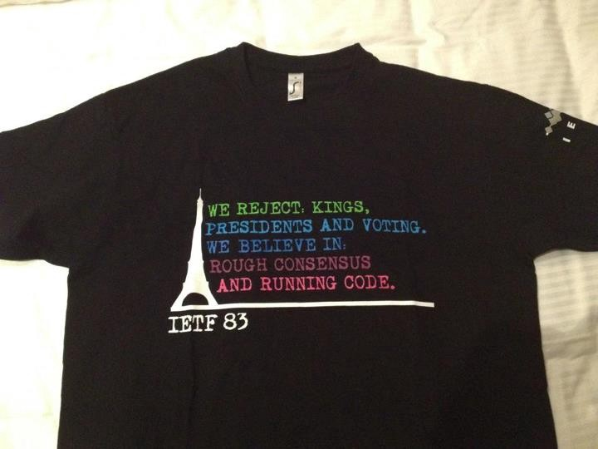
Notes:
This brought about a shift where not just government had a vote, but new standardization bodies, such a the Internet Engineering Taskforce too, which led to the statement that….
The Internet and its institutions brough about a sense that the power of the nation state was waning
Also fitted with the 90s Washington Consensus and The End of History
The Soviet Union, the maker of Sputnik, was beaten by the US and the Internet
The Internet would bring freedom from tyranny by nation states
Some scholars already then argued this would just replace US military with US corporate power.
We are now at the end of that era

Slide 11
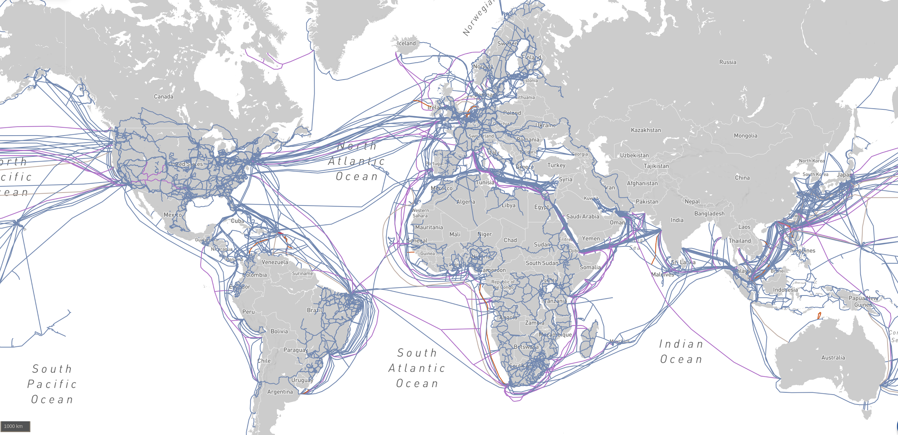
Notes:
Submarine cables are no not just between Europe and the US, but connect the whole world

Slide 12
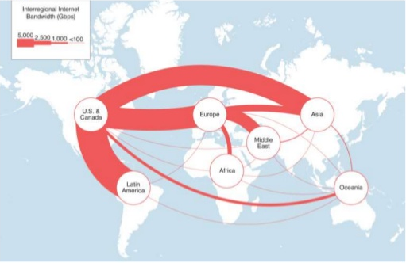
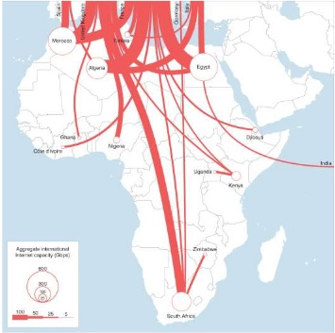
Notes:
But when one looks at the shape of data streams, on sees something very different
Reliance of the world on US data centers
Almost total reliance of Africa on Europe

Slide 13
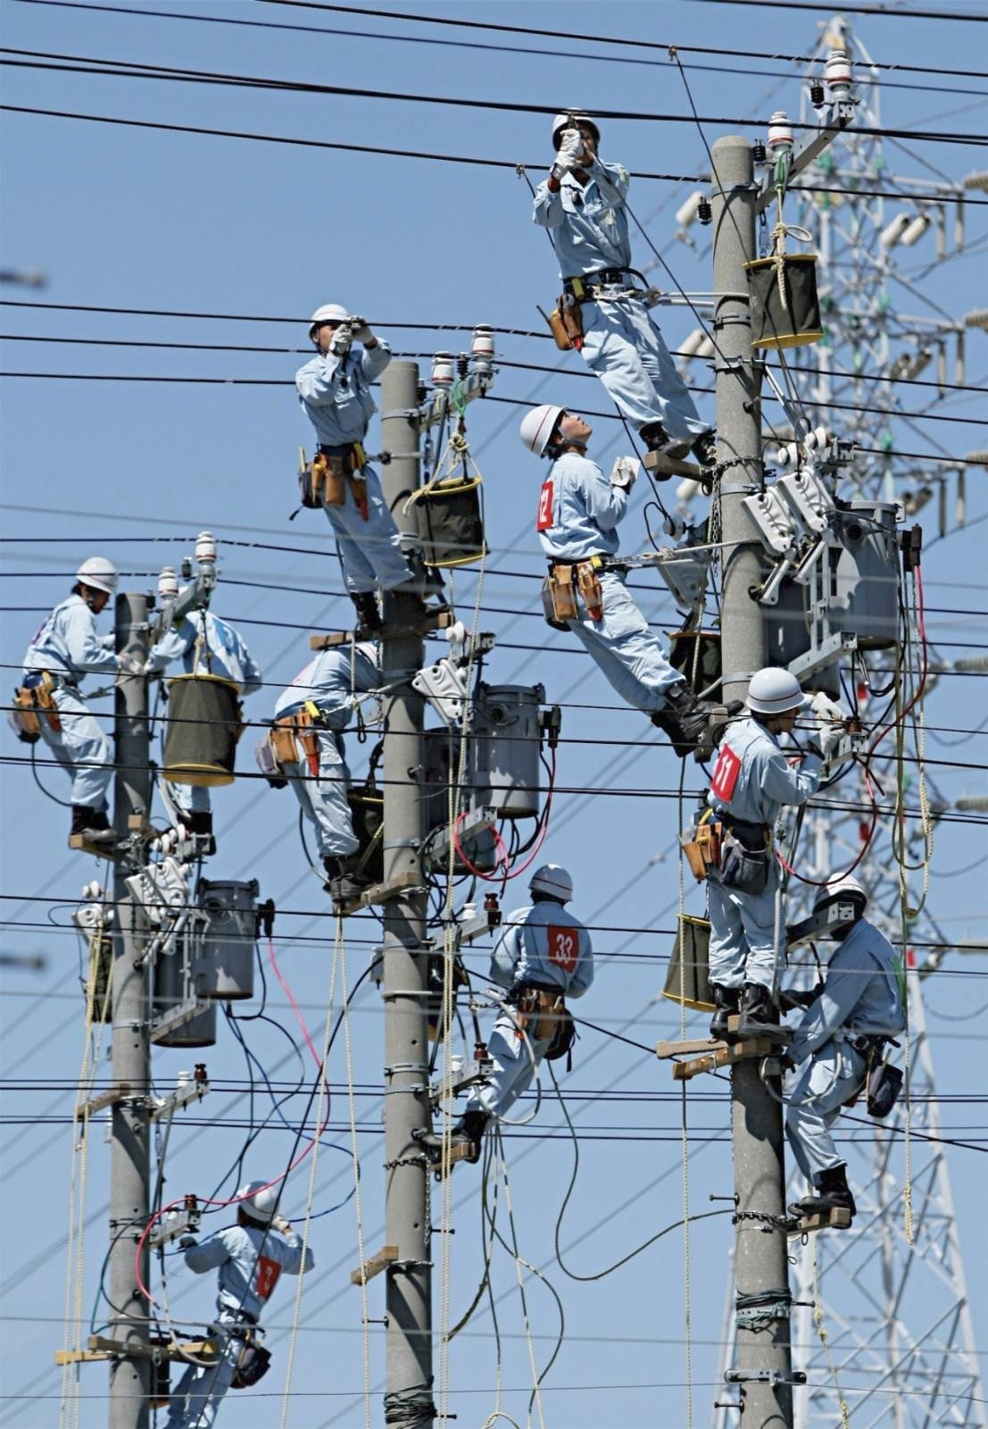
Notes:
This spurred the development of new technologies in rising world powers, such as China and Korea.

Slide 14
}
}
Application
API’s (for instance for social media networks), HTML, CSS →W3C
}
Presentation
Session
HTTP, QUIC, TLS, TCP, DNS, BGP → IETF
Transport
}
5G in 3GPP
Network
}
Data Link
WiFi, ethernet → IEEE
2G, 3G, 4G
→ 3GPP
Physical

Slide 15


Slide 16
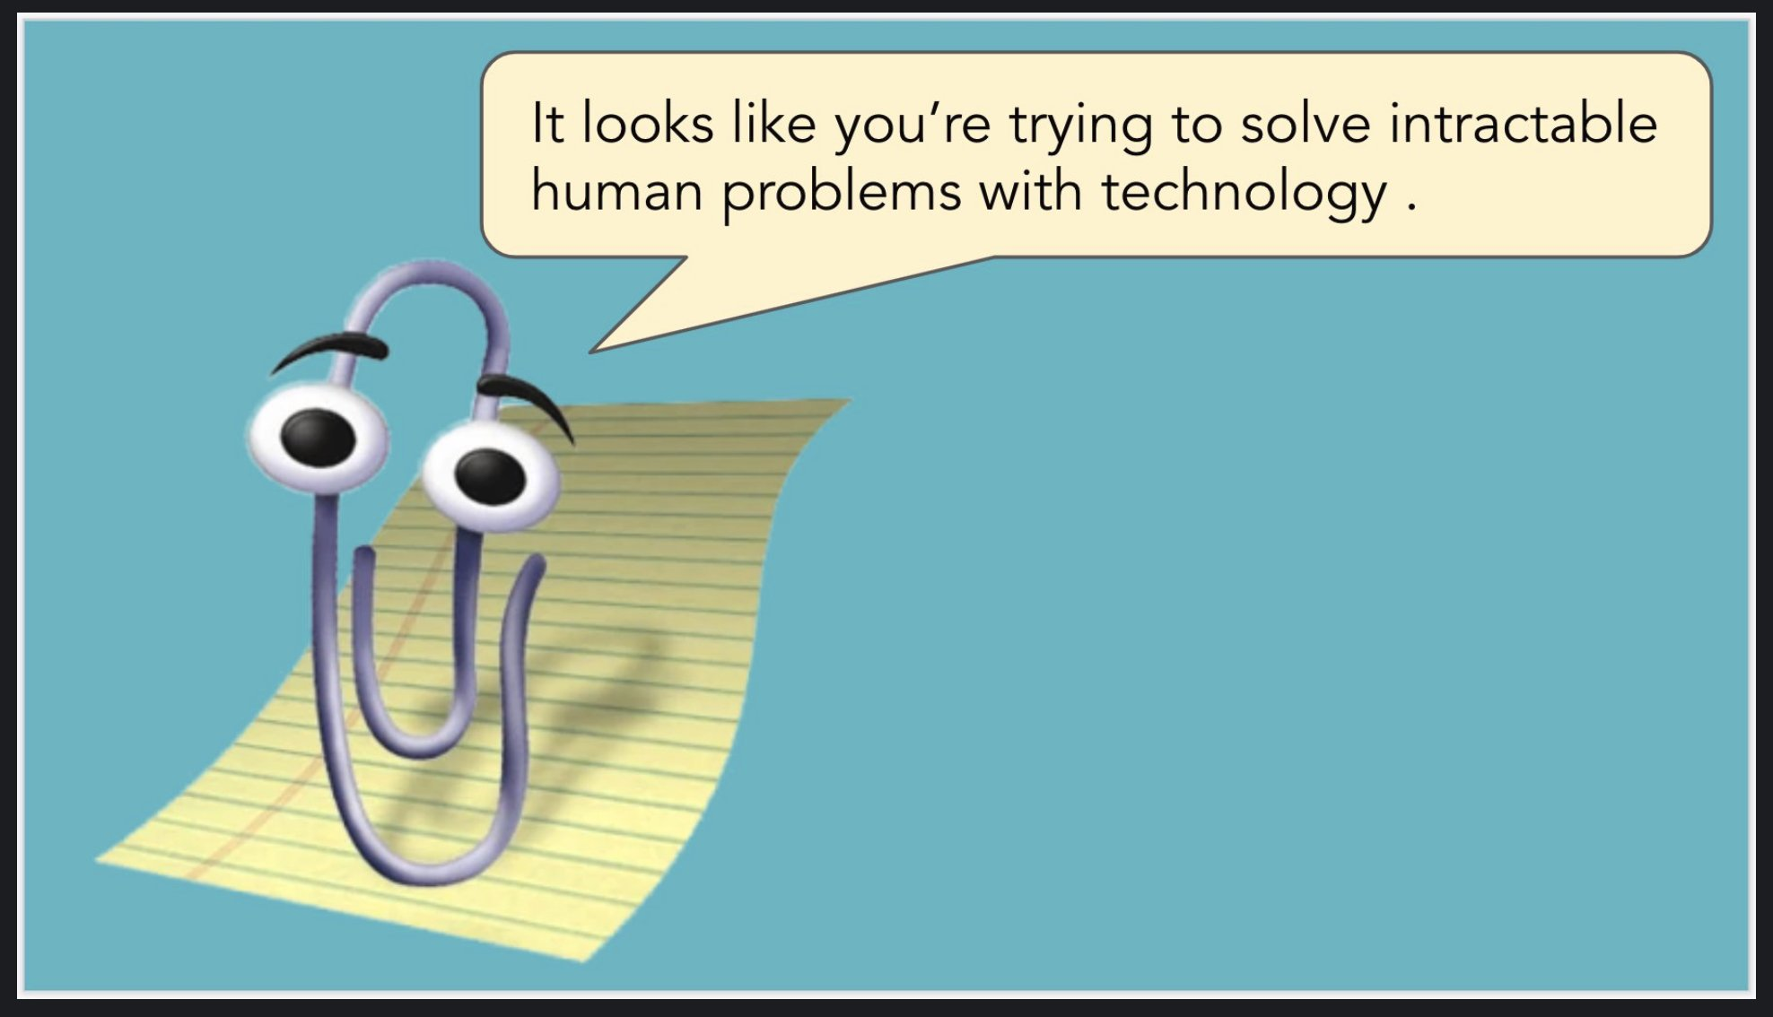

Slide 17
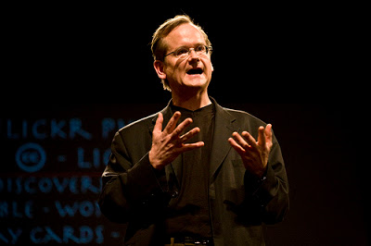
Law (legal)
Social values & acceptance
(social norms)
Architecture
(techno-material)
Market (socio-economic)

Slide 18
Three overlapping governance regimes
Private Internet Governance
Telecommunications regime
National and multilateral governance regime
How do these align?
How is power exerted?

Slide 19


Slide 20

Notes:
Technology should be a means of personal and societal reflection and emancipation
Technology and communication networks never exist by themselves
They represent societal powers and inequalities
Changes to networks and technologies therefore need to be grounded in intersectional analysis

Slide 21


